Slide 1
Technical Personal Development

Slide 2
Agenda
Who
Why
Where
1
2
3
4
5
6
What
How
Finally

Slide 3



Who am I?
1
Email: mrrobsewell@outlook.com
Profile:
Rob Sewell
Twitter: fade2blackuk
Blog:
sqldbawithabeard.com
Notes:
Just to show you how to contact me – You don’t need any more than that

Slide 4
What NOT?
2
Making Flashy Reports
Using The Latest Tools
Buidling A Quality Application For Any Platform
Managing and Administering Data
Extracting, Transforming and Loading Your Data

Slide 5
So What?
2
The Importance of
Continual Technical
Development
The Benefit of Enabling Technical Development
Some Resources
For Self Development
People, Places and
Groups

Slide 6
Why?
3
As Technology Evolves Capability Improves
So does Speed. Of Performance
Of Delivery
Of Requirements
Fast Feedback Fail Early Financial Gain
You Want (To Be)
These People
Notes:
The Importance of Continual Technical Development for managers as the techies know they need to keep up
Between 20 to 30 % speed improvements using SQL 2014 compared to SQL2012
Technology evolves very very quickly and with Agile Development new features are added very quickly. Now we use devops think about it like this when you started to drive your car you unlocked, put on seatbelt, checked not in gear, started engine, checked mirrors, looked over your shoulder, pressed the clutch etc walk it through. Changing lanes on the motorway was tricky. Now you can do all of those things without really thinking about them
Visual Studio an extremely popular developers tool has a 3 week release cycle, every three weeks they release changes to the product
For example, one in four Americans abandons surfing to a website if its page takes longer than four seconds to load. That's just four "Mississippis," guys. Four in 10 Americans give up accessing a mobile shopping site that won't load in just three seconds
Amazon's calculated that a page load slowdown of just one second could cost it $1.6 billion in sales each year. Google has calculated that by slowing its search results by just four tenths of a second they could lose 8 million searches per day—meaning they'd serve up many millions fewer online adverts.

Slide 7
How – For Non-Techies
4
Enable Training
Encourage
Break Out
Sessions
Sponsor/Host Groups
Employ the People Who Learn

Slide 8
How – For Techies
4
Listen Read Watch
User Groups
Conferences
Ask!
Write Record Present

Slide 9






Where?
5
Windows PowerShell Reference on MSDN
http://powershell.org/
Hey Scripting Guy
Powershell Magazine
Script Center
Pluralsight
Laerte Junior
Simple Talk
DBA Stack Exchange
And Many More!! (I have missed loads)

Slide 10






Where?
5
Windows PowerShell Reference on MSDN
http://powershell.org/
Hey Scripting Guy
Powershell Magazine
Script Center
Pluralsight
Laerte Junior
Simple Talk
DBA Stack Exchange
And Many More!! (I have missed loads)

Slide 11
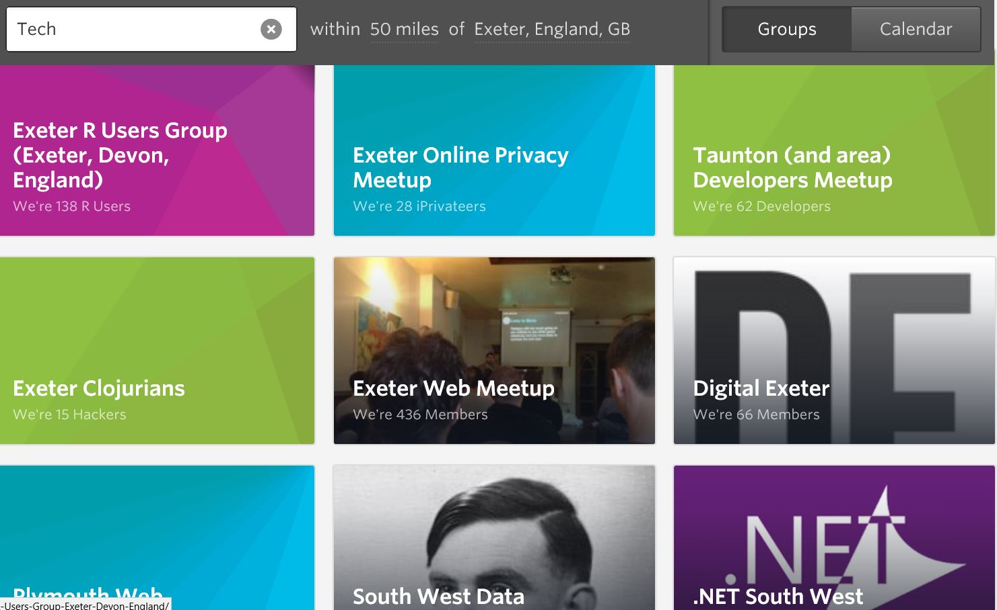

Where?
5
SQL South West
Notes:
MEETUP

Slide 12
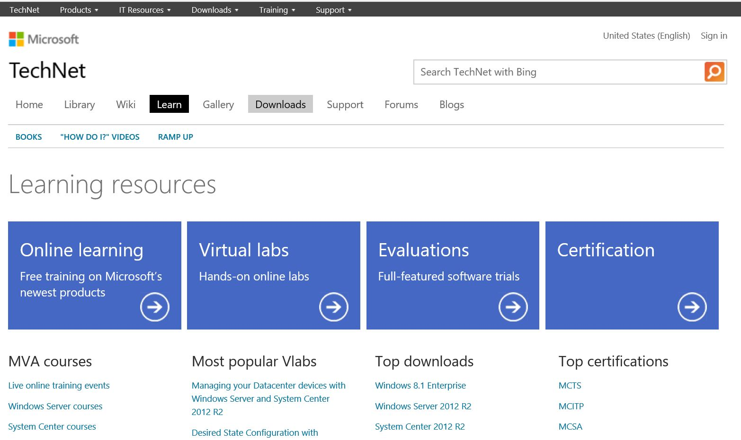
Where?
5
SQL South West
Microsoft TechNet
Notes:
MICROSOT TECHNET
https://technet.microsoft.com/en-us/learning/bb291022.aspx

Slide 13
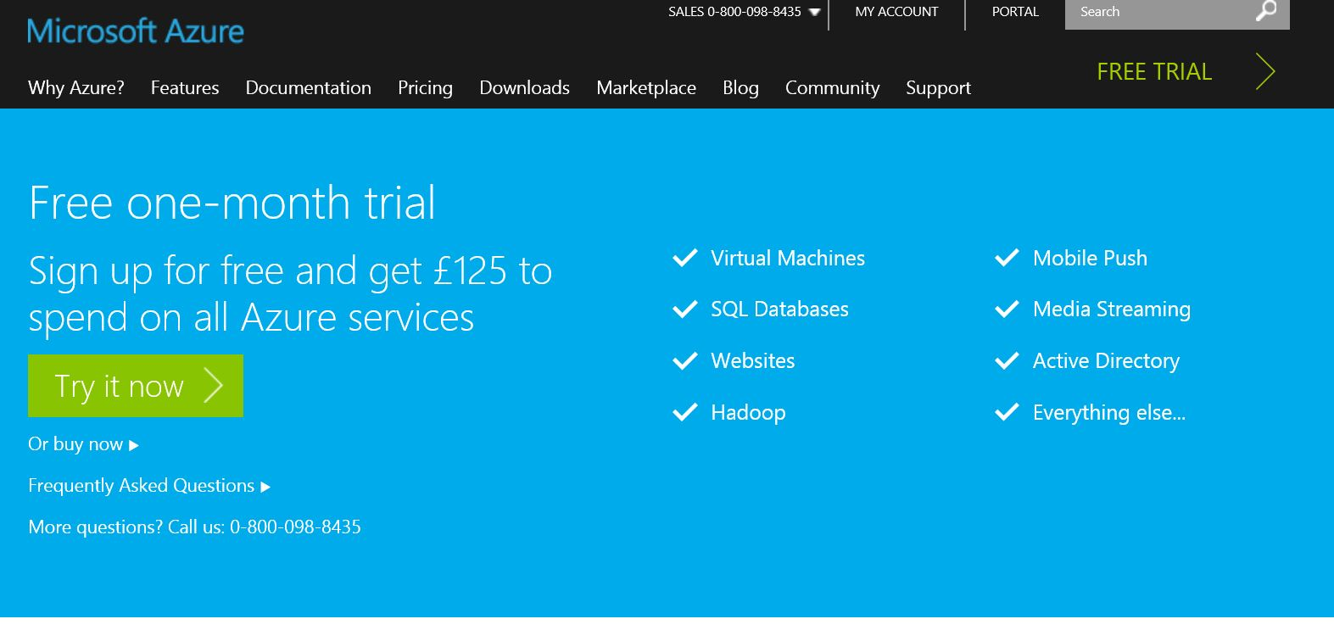
Where?
5
SQL South West
Microoft TechNet
Microsoft Azure
Notes:
MICROSOFT AZURE

Slide 14
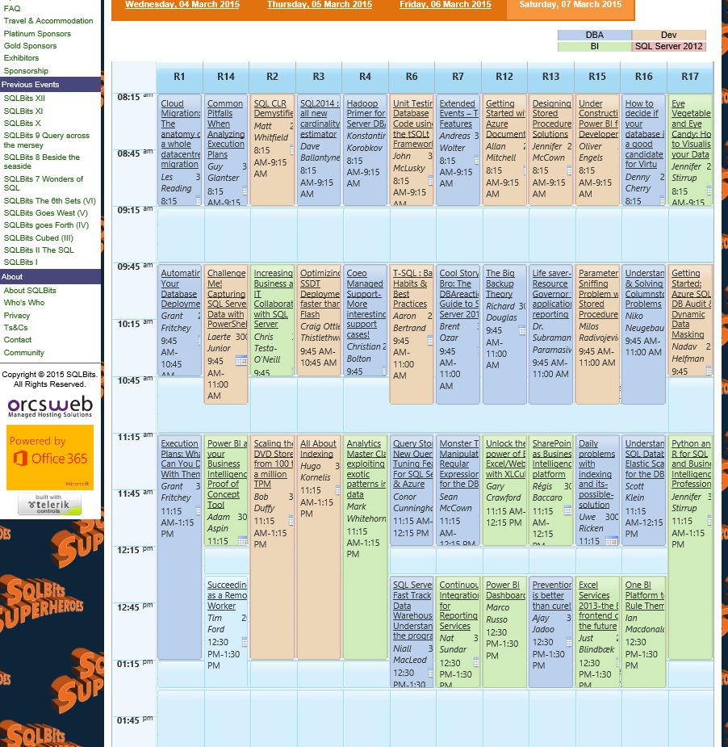
Where?
5
SQL South West
Jurys Inn
Exeter
3rd Mon
Microsoft TechNet
Microsoft Azure
SQL Bits
Microsoft TechNet
Microsoft Azure
SQL Bits
Notes:
MEETUP

Slide 15
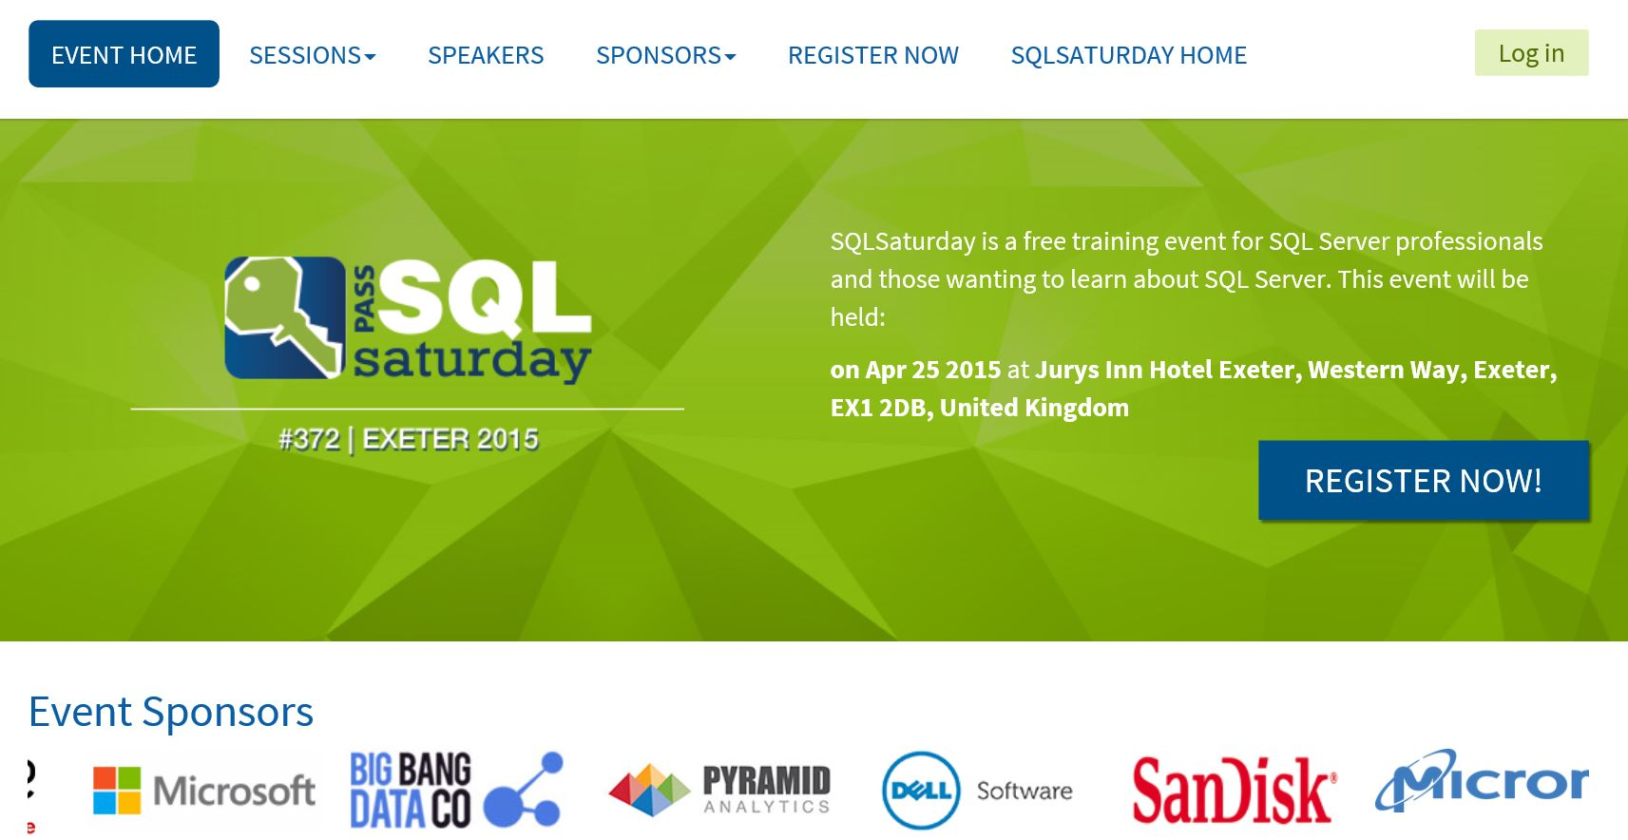
Where?
5
SQL South West
Jurys Inn
Exeter
3rd Mon
Microsoft TechNet
Microsoft Azure
SQL Bits
Notes:
MEETUP

Slide 16
Where? – AT HOME!
5
Blogs and websites
SQLServerCentral
SimpleTalk
StackExchange
A List of resources you’ll never finish http://tenbulls.co.uk/enlightenment/training-resources/
A list of super bloggers
http://thomaslarock.com/rankings/
Twitter
You won’t go wrong starting with this list
https://twitter.com/BrentO/lists/sql-server/members
Windows PowerShell Reference on MSDN
http://powershell.org/
Hey Scripting Guy
Powershell Magazine
Script Center
Pluralsight
Laerte Junior
Simple Talk
DBA Stack Exchange
And Many More!! (I have missed loads)

Slide 17
Hopefully
6
You have learnt
Why You Need To (Or Need to Enable) Technical Self Development
How It Benefits You (Or Your Business)
A Number of Online Resources
Some People and Groups to meet

Slide 18
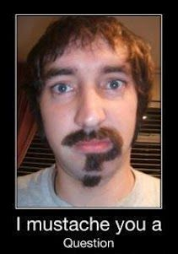
Questions
6

Slide 19
Contact Me
Email: mrrobsewell@outlook.com
Profile:
Rob Sewell
Twitter: fade2blackuk
Blog:
sqldbawithabeard.com
SQL South West
http://SQLSouthWest.co.uk
@SQLSouthWest
Notes:
Just to show you how to contact me – You don’t need any more than that

